Slide 1

Explainable AI-Driven Multimodal Analytics for Sustainable Smart City Decision Intelligence
Batch No: 04
Team Members:
Pathi Sharmila-2420030042
Lakshman Angara-2420030067
Ivaturi Vennela-2420030185
Vishnu Priya Kodali-2420030630

Slide 2
Methodology
1. Data Collection & Preparation
Collection of Air Quality, Weather and Energy Consumption datasets.
Initial inspection of shape, data types, missing values, duplicates and statistical characteristics.
Dataset-specific cleaning, including handling missing values, duplicate records, invalid values and irrelevant attributes.
Storage of cleaned datasets for further analysis.
2. Exploratory Data Analysis
Univariate analysis to study distributions, frequencies and outliers.
Bivariate analysis to identify relationships between important variables.
Multivariate analysis to understand interactions among multiple features.
Correlation analysis and heatmaps to identify relationships and redundant features.
EDA graphs are saved for analysis and research-paper documentation.
3. Feature Engineering
Creation of meaningful domain-specific features from the cleaned datasets.
Air Quality: PM Ratio, NOx/NO2 Ratio, CO/CO2 Ratio, Pollution Score and Pollution Level.
Weather: Year, Month, Hour, Day of Week, Season, Temperature Difference and Wind-Chill Indicator.
Energy: Hour, Month, Weekend, HVAC Status, Lighting Status and energy-related indicators.

Slide 3
Methodology
4. Feature Selection & Leakage Prevention
Selection of relevant features using correlation, redundancy and domain relevance.
Removal of highly correlated or unnecessary features.
Identification and removal of features that directly use the target variable.
Separate leakage-safe feature sets are prepared for each prediction task.
5. Predictive Modeling
Numerical and categorical features are processed using appropriate imputation, scaling and encoding techniques.
Training and testing datasets are prepared using an 80:20 split, with chronological splitting for Weather data.
Linear Regression, Decision Tree Regression and Random Forest Regression are trained for all three domains.
Model predictions are generated on unseen test data.
6. Model Evaluation & Selection
Models are evaluated using MAE, MSE, RMSE and R² Score.
Performance of the three algorithms is compared independently for each domain.
The best-performing baseline model is selected for Air Quality, Weather and Energy.
The selected models are saved for further hybrid modeling and deployment.

Slide 4
Methodology
7. Proposed Hybrid Modeling
The selected baseline model first generates the domain prediction.
The residual error between actual and predicted values is calculated.
A secondary model learns the patterns in these residual errors.
The predicted residual is added to the base prediction to obtain the hybrid prediction.
Baseline and hybrid models are compared to determine whether prediction accuracy improves.
8. Explainability & Error Analysis
SHAP is applied to identify the contribution of individual features to model predictions.
Feature-importance and SHAP summary visualizations are generated for each domain.
Residual analysis is used to examine remaining prediction errors.
The combined analysis provides an error-aware explanation of model behavior.
9. Decision Support & Dashboard
Integrated predictions are converted into interpretable smart-city conditions using justified criteria.
Relevant decision-support information and recommendations are generated.
A Streamlit dashboard provides interactive prediction and visualization for all three domains.
Predictions, model performance and SHAP explanations are presented through the dashboard.

Slide 5
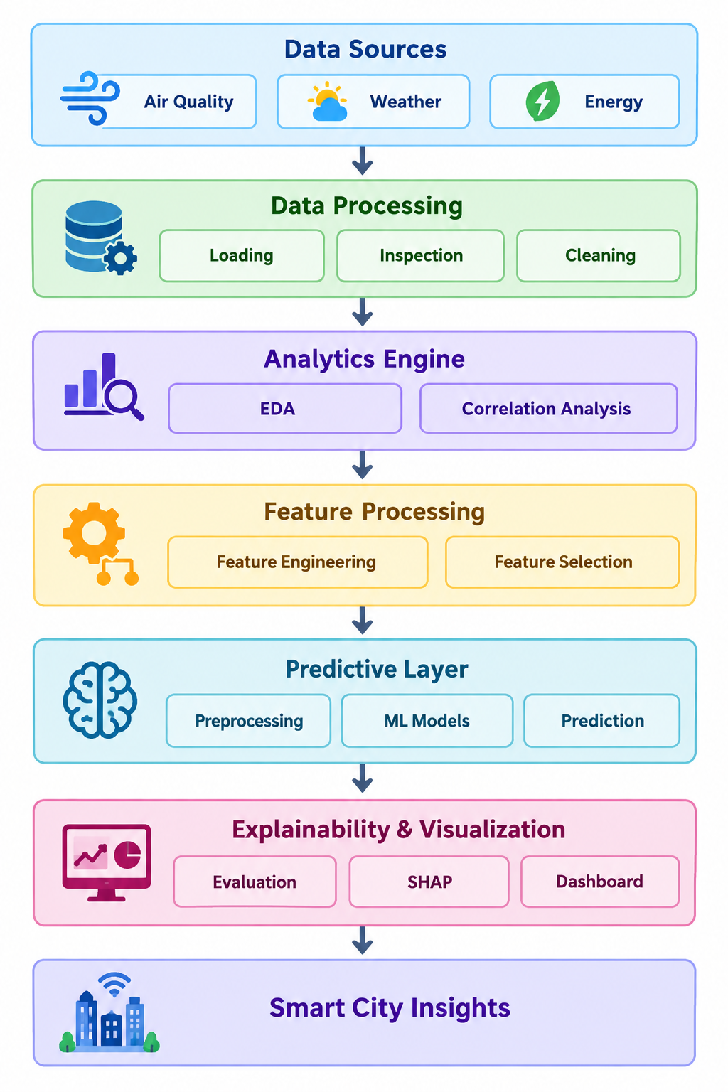
System Design
Data Sources
Air Quality | Weather | Energy
↓
Data Processing
Loading | Inspection | Cleaning
↓
Analytics Engine
EDA | Correlation Analysis
↓
Feature Processing
Feature Engineering | Feature Selection
↓
Predictive Layer
Preprocessing | ML Models | Prediction
↓
Explainability & Visualization
Evaluation | SHAP | Dashboard
↓
Smart City Insights

Slide 6
Modern Tools & Technologies
Category | Tool / Technology | Purpose in the Project
Programming Language | Python | Core language for data analysis, preprocessing and project implementation
Development Environment | Jupyter Notebook | Interactive development, analysis and experimentation
Development Environment | PyCharm | Organized project implementation and management
Data Processing | Pandas | Data loading, cleaning, transformation and analysis
Numerical Computing | NumPy | Numerical operations and array-based computation
Data Visualization | Matplotlib | Histograms, box plots and analytical visualizations
Data Visualization | Seaborn | Statistical plots, correlation analysis and heatmaps
Data Storage | CSV | Storage and handling of the project datasets
Machine Learning | Scikit-learn | Model development, prediction and performance evaluation
Explainable AI | SHAP | Interpretation and explanation of machine-learning predictions
Dashboard / Visualization | Interactive Dashboard | Presentation of analytical insights and model results

Slide 7
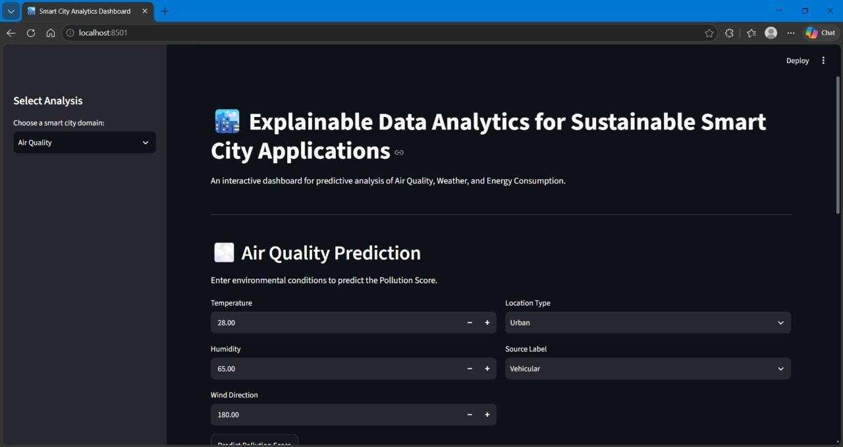
Implementation

Slide 8
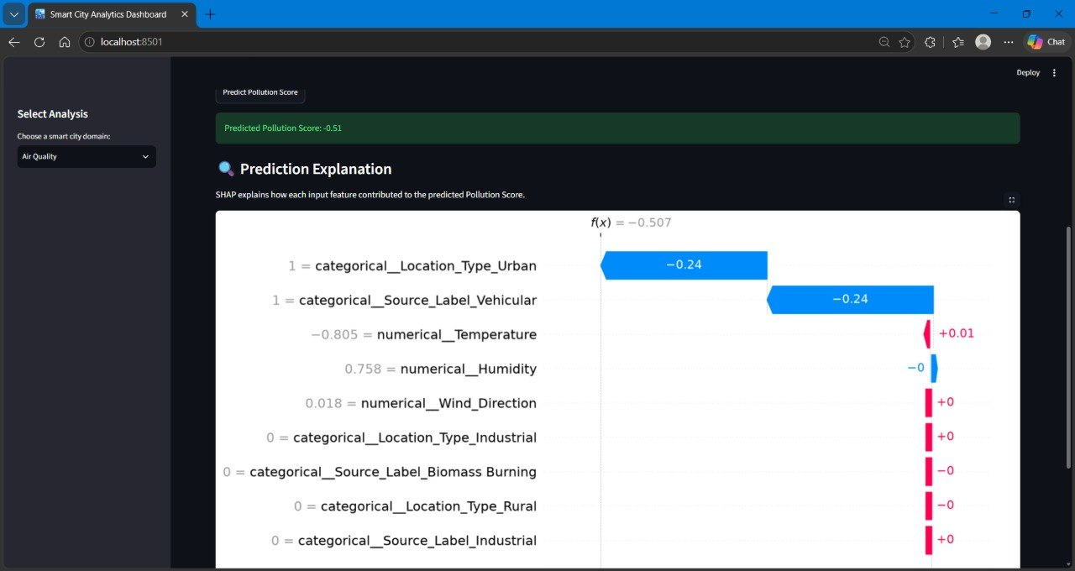

Slide 9
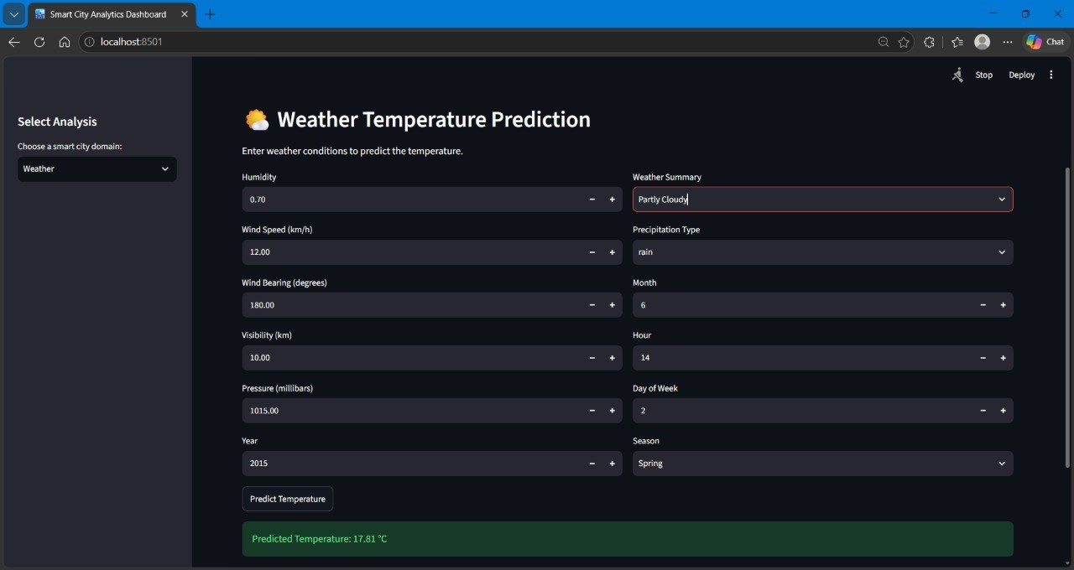

Slide 10
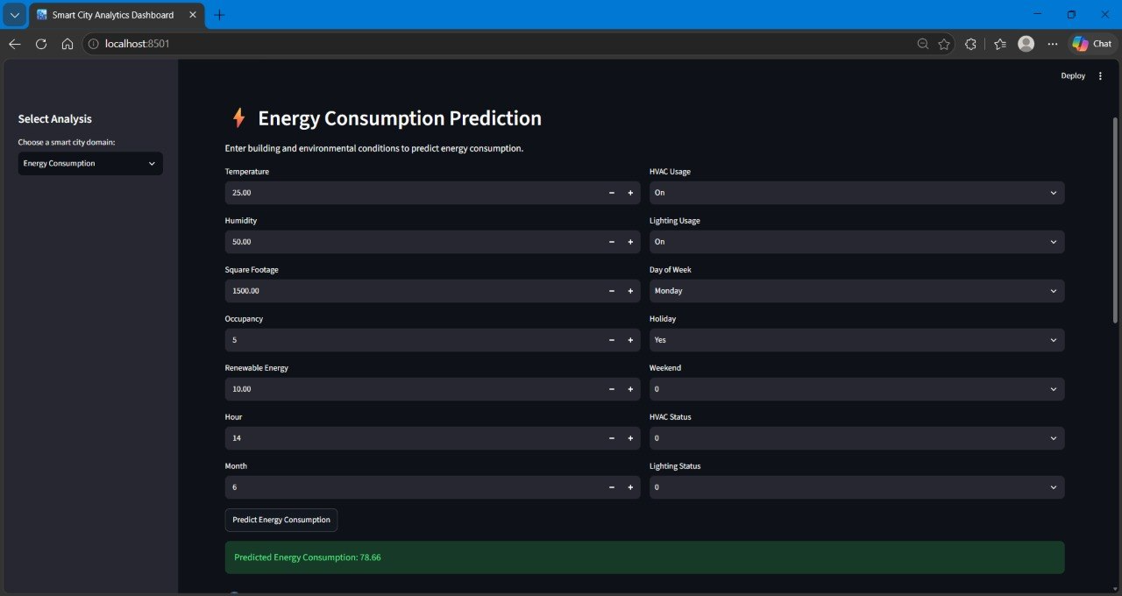

Slide 11
Results
Data Cleaning
Successfully cleaned all three datasets by handling missing values, duplicates, and invalid records.
Generated clean datasets ready for analysis.
EDA Findings
Identified important data distributions, patterns, outliers, and correlations.
Detected highly correlated and redundant features.
Feature Engineering
Created meaningful domain-specific features for Air Quality, Weather, and Energy datasets.
Feature Selection
Reduced feature redundancy using correlation analysis (|r| > 0.85).
Identified and avoided potential target leakage.
Final Outcome:
Cleaned Data → EDA Insights → Engineered Features → Selected Features → Ready for Predictive Modeling

Slide 12
Performance Evaluation
The predictive models will be evaluated and compared based on their ability to generate accurate and reliable predictions.
MAE: Measures average prediction error.
MSE: Penalizes larger errors more heavily.
RMSE: Measures error in the target’s original scale.
R² Score: Measures how well the model explains the target variation.
Model Comparison:
Different ML models will be trained and compared using these metrics.
Final Selection:
The best-performing model will be selected for prediction and explainability.
Flow:
Selected Features → Model Training → Prediction → Evaluation → Best Model

Slide 13
Thank You

